Slide 1
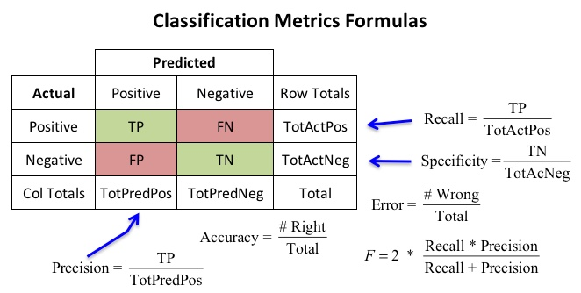
Classification Metrics
Precision and Recall
Precision and Recall both focus on positive predictions.
FP (False Positive) - Type 1 Error : This is linked to Precision
FN (False Negative) - Type 2 Error : This is associated with Recall (also called Sensitivity).

Slide 2

Precision: It measures how many of the positive predictions made by the model were actually correct. It's like checking how accurate the model is when it says something is positive.
Scenario:
Imagine a medical test that detects cancer. Out of 100 patients, the model predicts 15 people have cancer, but only 10 actually have it.
True Positives (TP) = 9 (Correctly predicted cancer)
False Positives (FP) = 6 (Wrongly predicted cancer)
False Negatives (FN) = 1 (Missed an actual cancer case)
Precision Formula:
Explanation:
Precision is about being accurate when the model predicts cancer.
Out of the 15 predictions of cancer, only 60% were correct.
Precision is important when false positives (wrong predictions) are costly, like cancer diagnosis.
Use Precision when false positives are costly. For example, predicting cancer when the person is healthy could lead to unnecessary treatments.
EG : Like a strict judge who only declares someone guilty when there is overwhelming evidence. They avoid false accusations.

Slide 3

Recall: It measures how well the model identified the actual positives, including some false predictions.
Scenario:
Using the same medical test, the actual number of cancer patients is 10, but the model only predicted 9 of them.
True Positives (TP) = 9 (Correctly predicted cancer)
False Negatives (FN) = 1 (Missed an actual cancer case)
Recall Formula:
Explanation:
Recall measures how well the model identified all actual positives.
In this case, the model caught 90% of actual cancer cases.
Recall is important when missing actual positives is risky, like failing to detect a disease.
Use Recall when false negatives are dangerous. For example, missing actual cancer cases can delay critical treatment.
EG: Like a security scanner at an airport that beeps at anything suspicious. It may beep at harmless objects, but it ensures no actual threat is missed.

